Slide 1
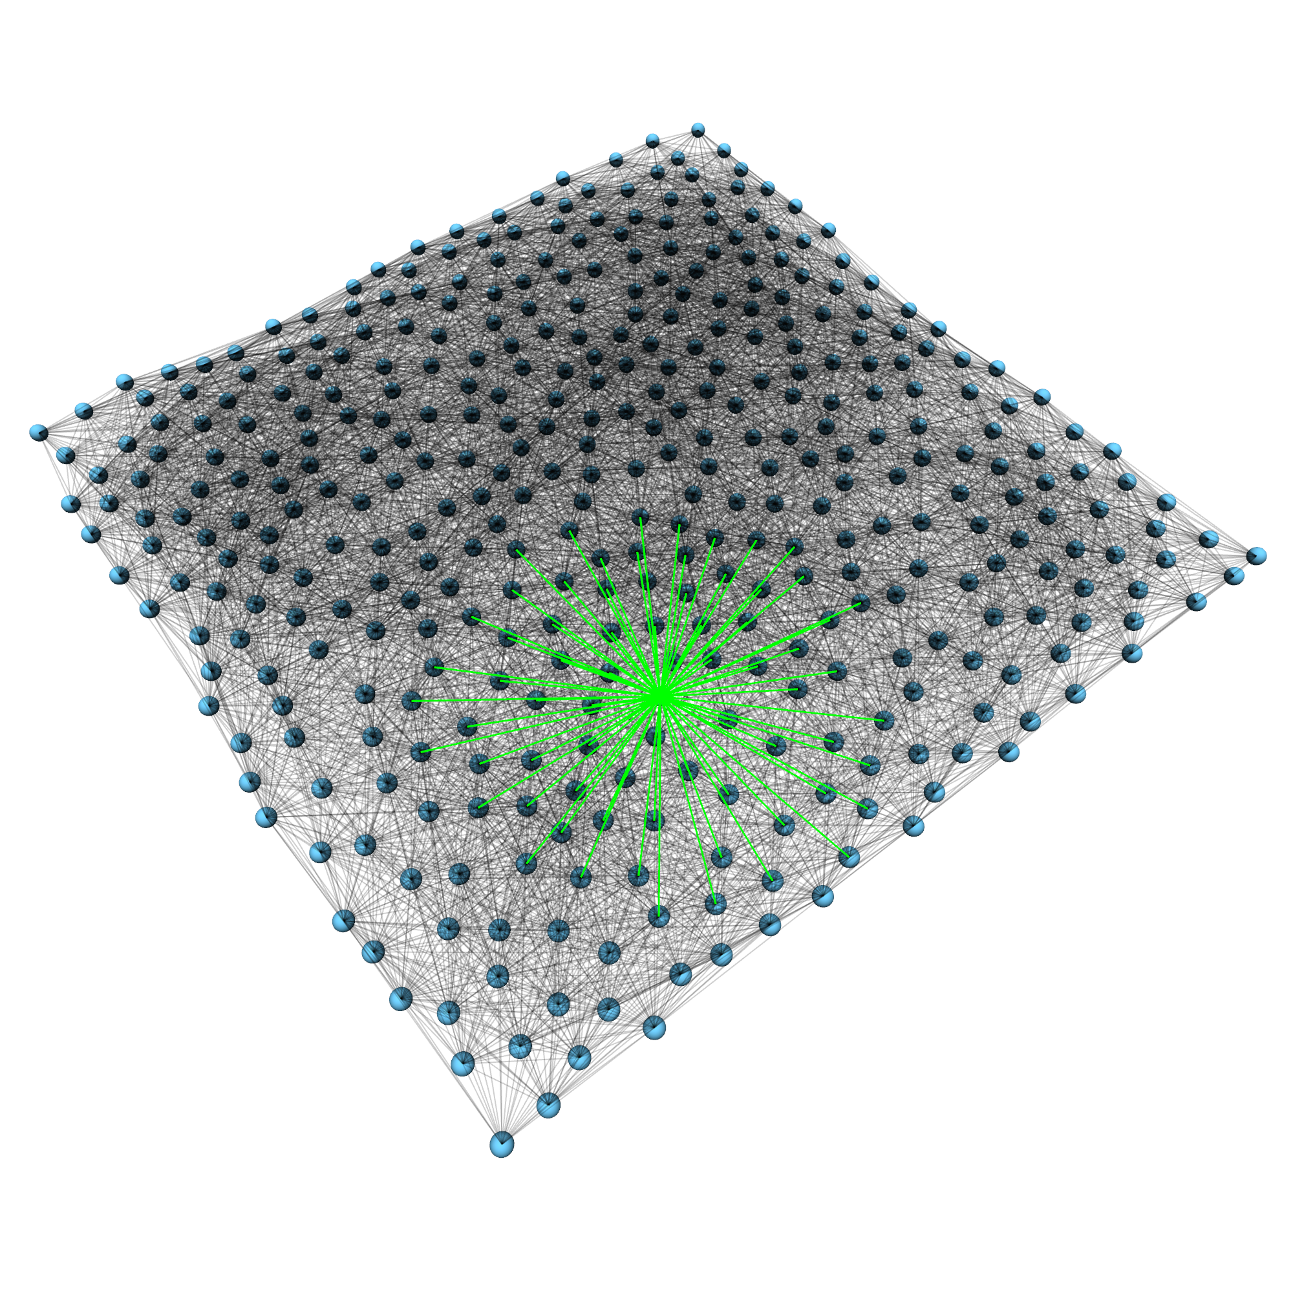
SpineML and SpineCreator
Alex Cope
University of Sheffield

Slide 2
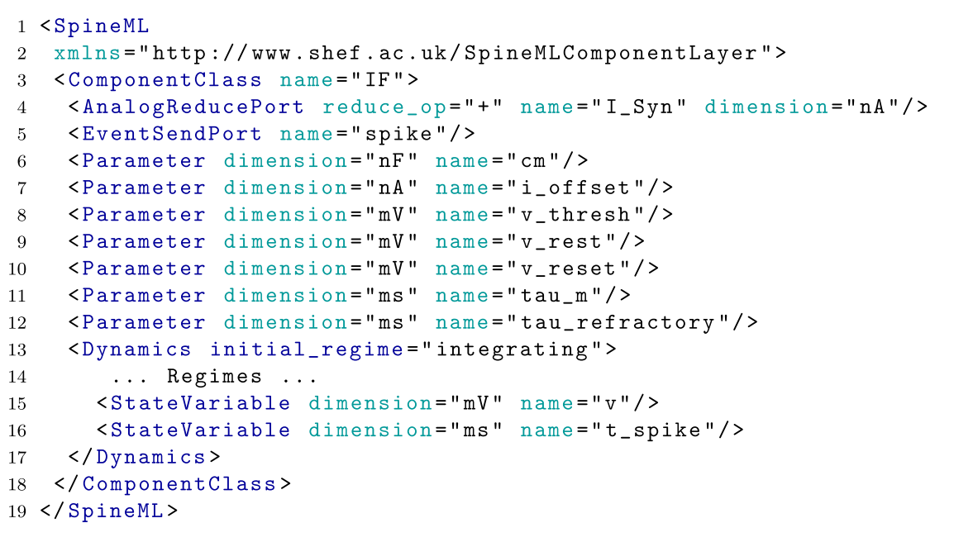
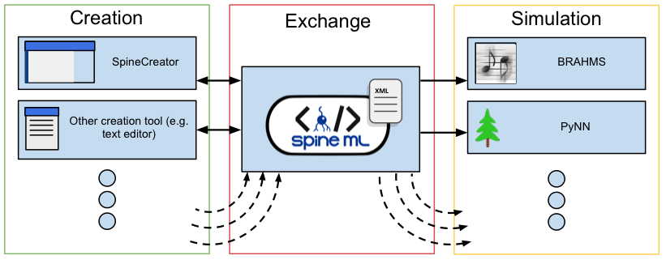
SpineML
SpineML is an XML-based description format for networks of point neurons
It is a proposed completion of the NineML format, including the description of neural dynamics, network structure, and experimental procedures.
SpineML acts as an exchange format between creation tools and simulators, as well as between collaborators working on a shared model
SpineML is published:
Richmond P, Cope A, Gurney K, Allerton DJ. "From Model Specification to Simulation of Biologically Constrained Networks of Spiking Neurons" Neuroinformatics. 2013

Slide 3
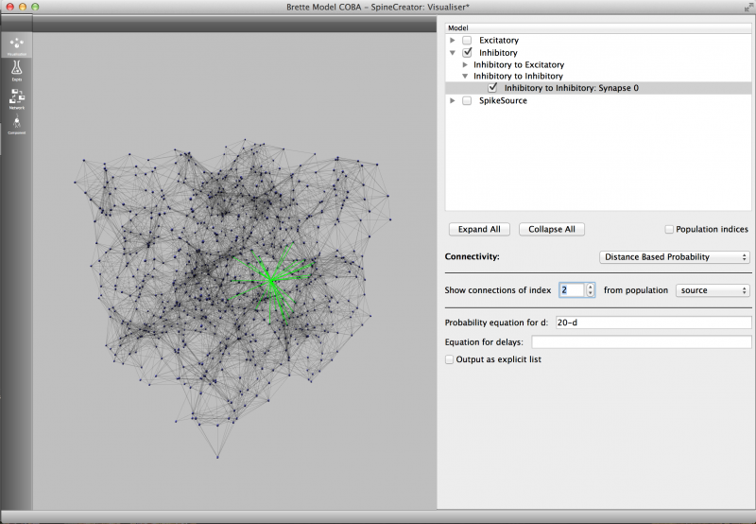
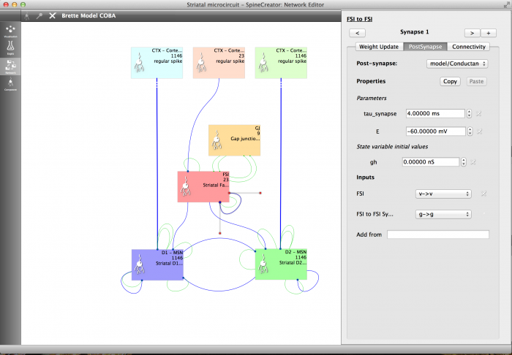
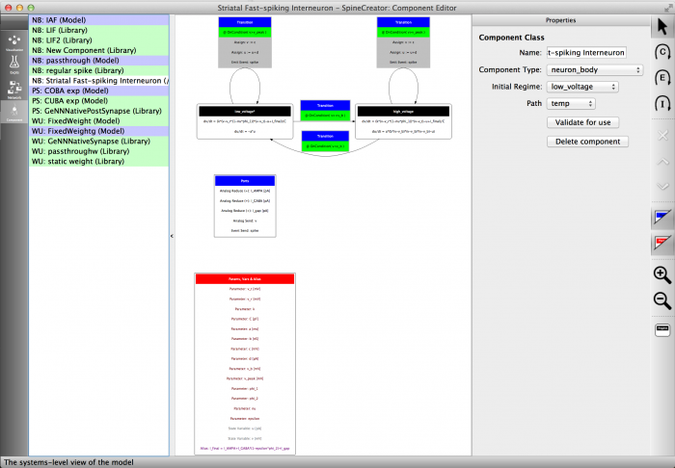
SpineCreator
SpineCreator is one tool that can be used to author SpineML models
A Graphical User Interface allows models to be specified without any programming
Some features:
Graphing
3d visualisation
Extensible simulator support
Version control support
Available at https://github.com/SpineML/SpineCreator

Slide 4
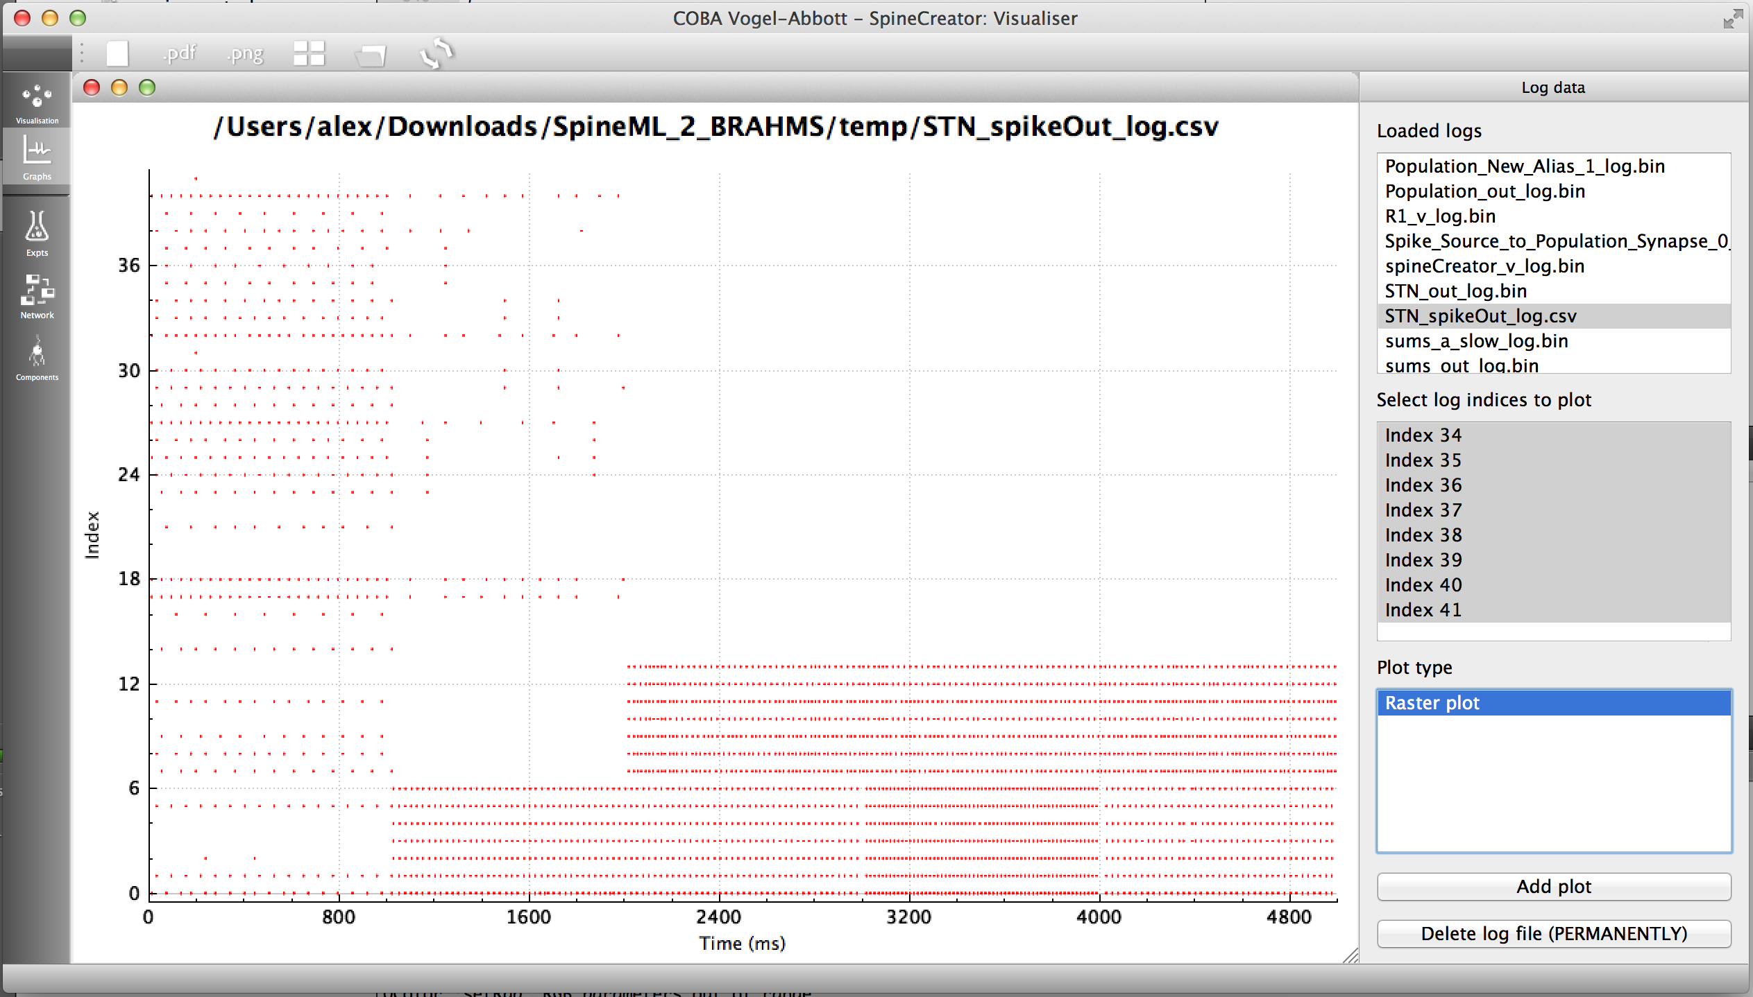
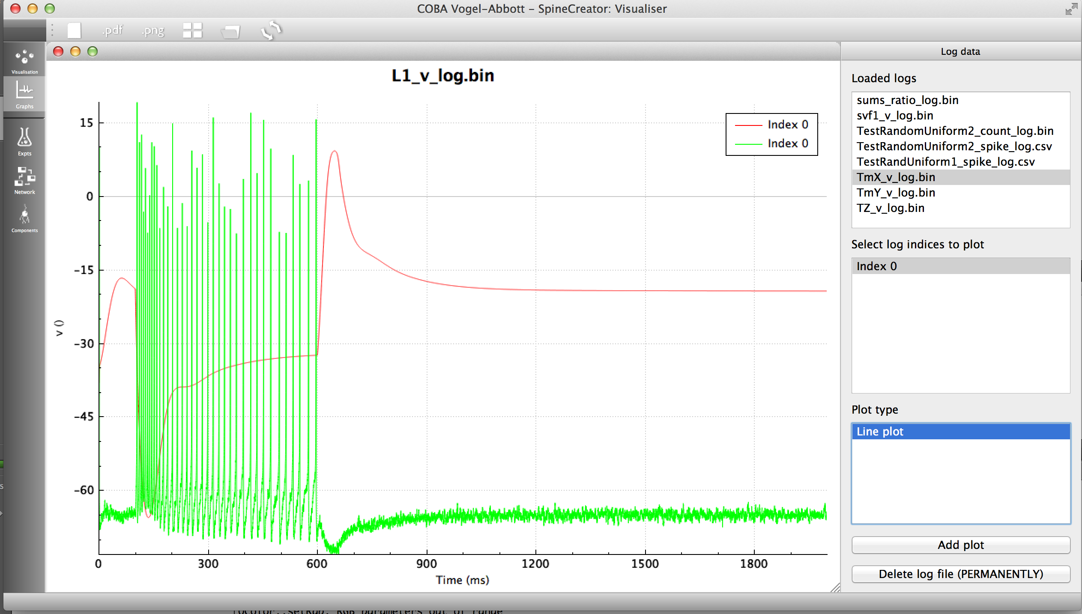
New features: built-in graphing
Based on QCustomPlot, which provides a rich interface for plotting graphs.
Can currently plot analog and event data (eg.membrane voltage; action potentials)
Have proposed an undergraduate project to enhance the capabilities of this element.

Slide 5
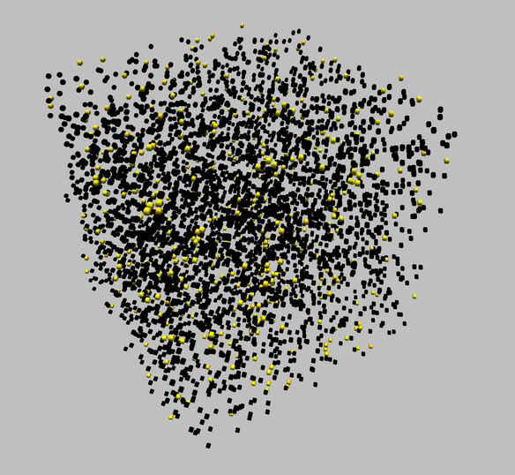

Slide 6
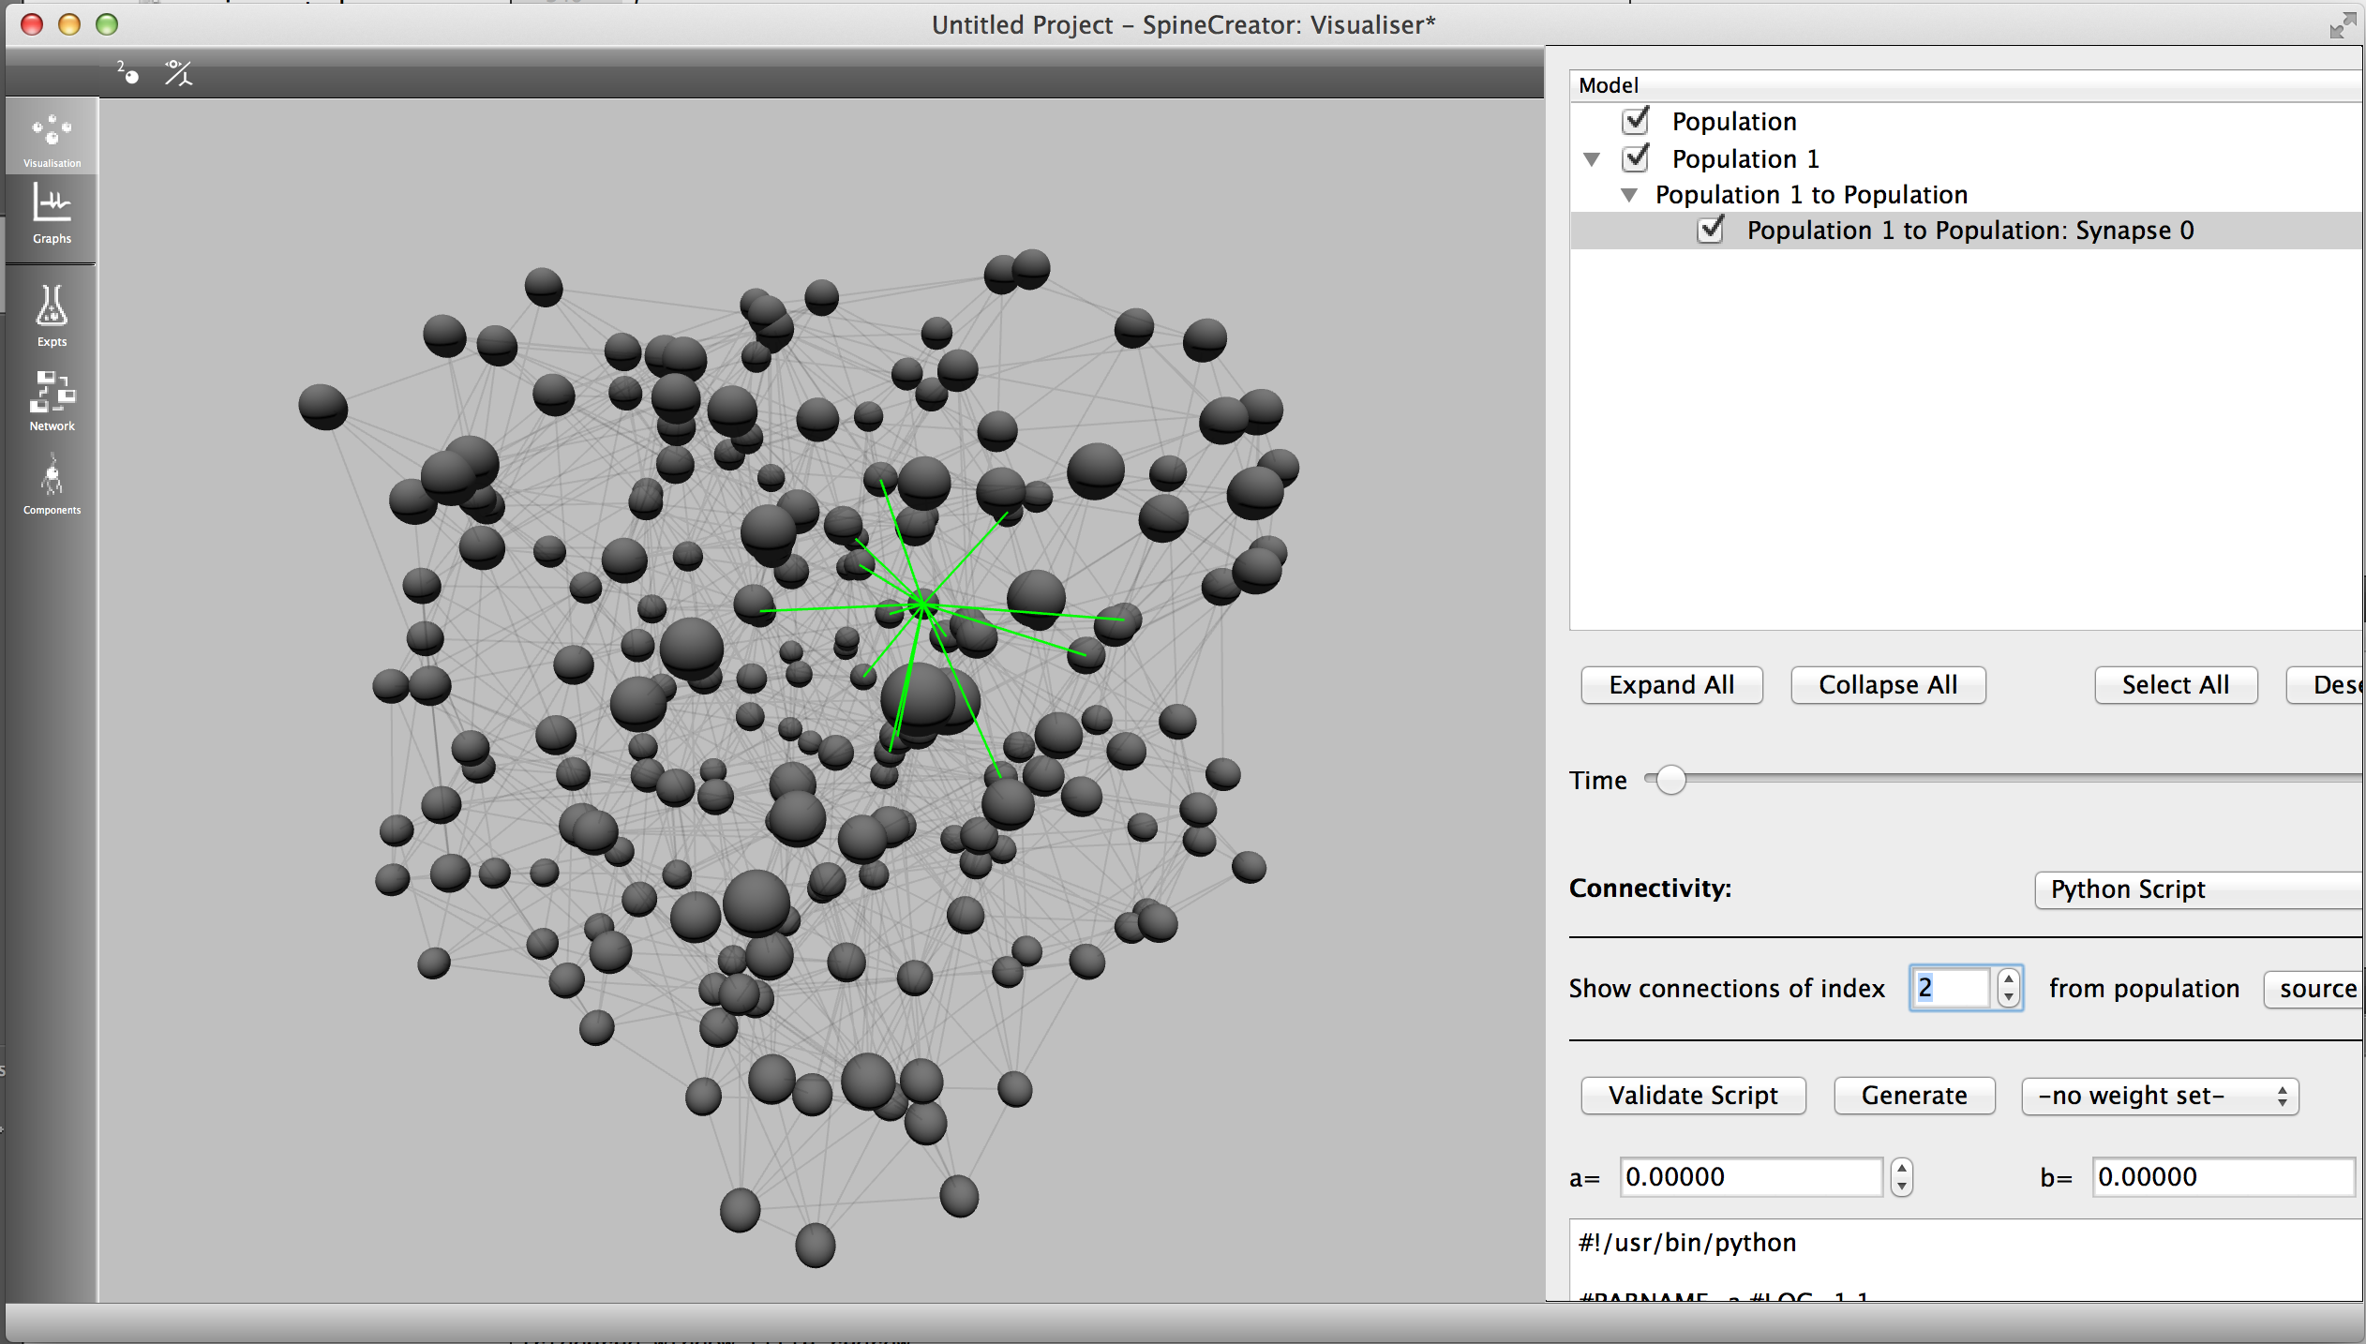
New features: extensible connectivity
SpineML specification currently defines a set of connection types: explicit connectivity lists can describe any connection
Generating connectivity lists in an external program possible, but more convenient to integrate this
Since these connection types are not declarative they are stored in spineCreator file, not SpineML. Explicit connections stored in SpineML
Scripts can generate delays
& weights also
#!/usr/bin/python
#PARNAME=a #LOC=1,1
#PARNAME=b #LOC=1,2
def connectionFunc(srclocs,dstlocs,a,b):
import math
i = 0
out = []
for srcloc in srclocs:
j = 0
for dstloc in dstlocs:
dist = math.sqrt(math.pow((srcloc[0] - dstloc[0]),2) + math.pow((srcloc[1] - dstloc[1]),2) + math.pow((srcloc[2] - dstloc[2]),2))
if dist < a:
conn = (i,j,0,b/a)
out.append(conn)
j = j + 1
i = i + 1
return out

Slide 7
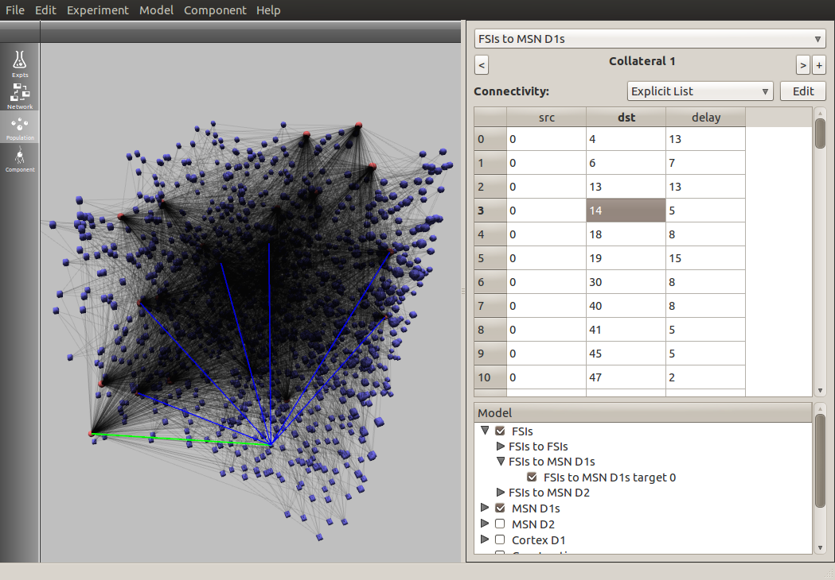
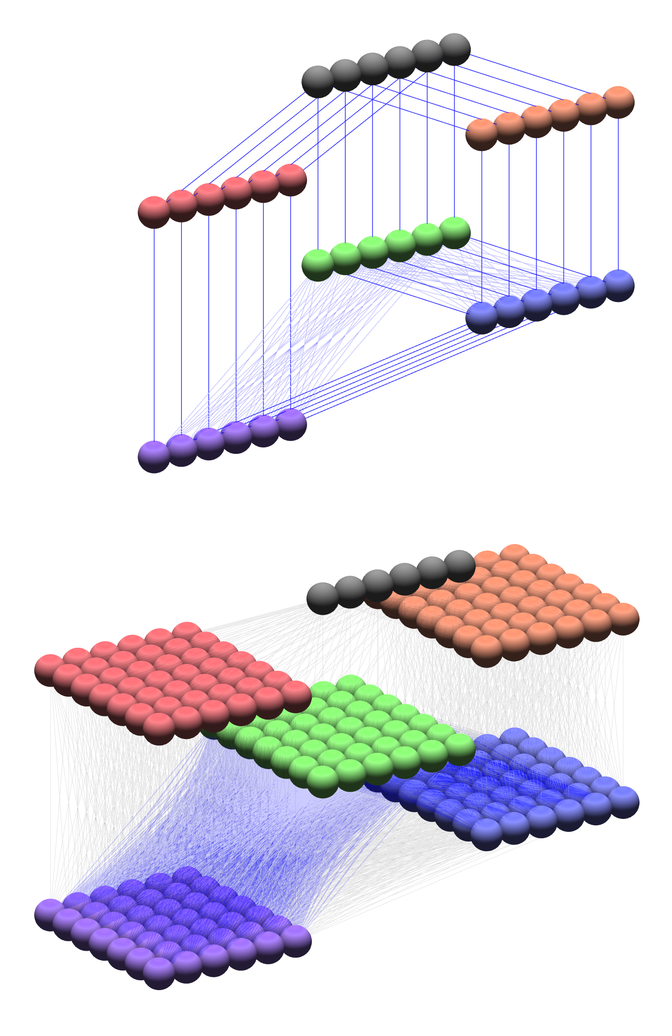
New features: refinements
Copy / paste
Undo / Redo
Tooltips
Recent projects menu
Multiple open projects
Import / export

Slide 8
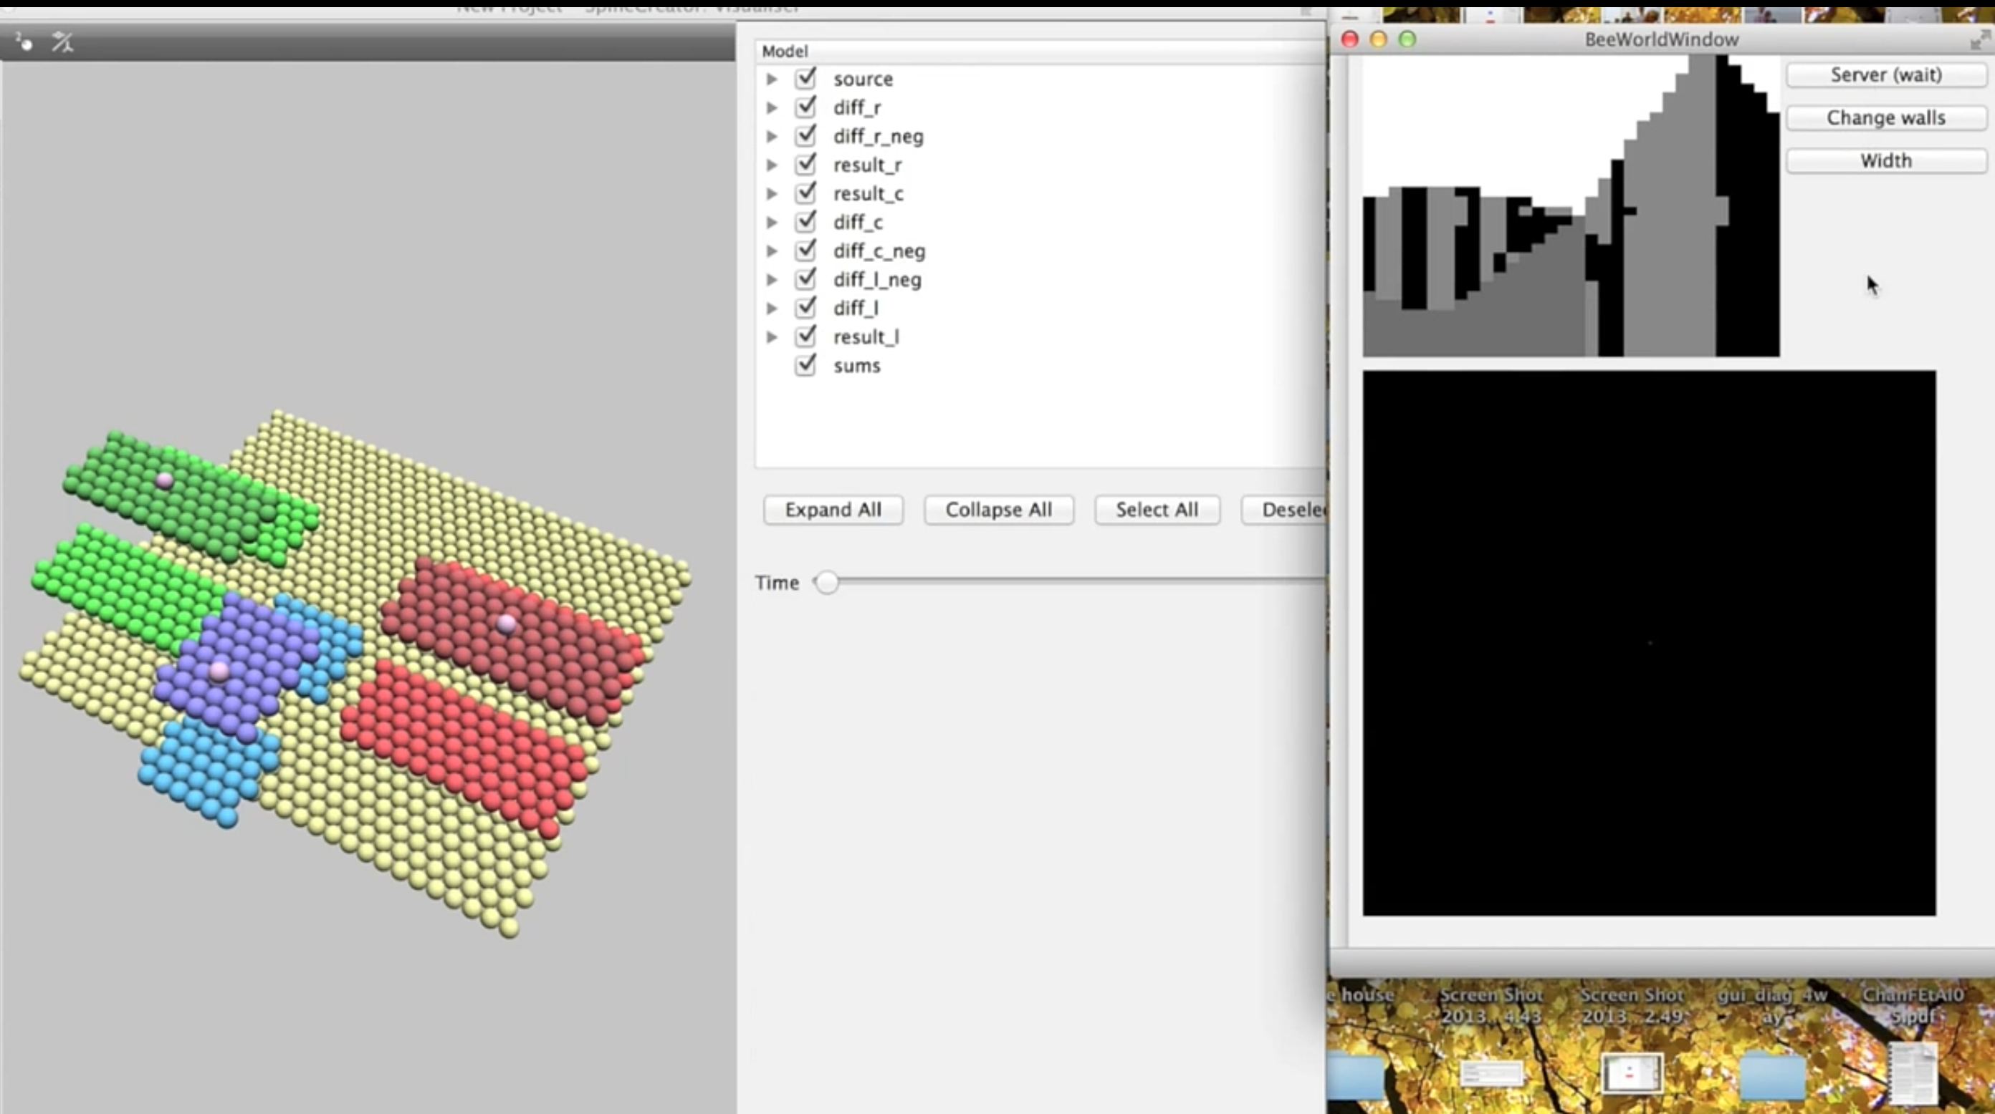
New features: external programs
SpineML can specify various inputs and outputs to a model.
Inputs put data in, outputs used for logging usually
External inputs & outputs connect via TCP/IP to other programs.
Simple API for inclusion in other software
Allows connection of complex environments or robotic hardware to SpineML models

Slide 9

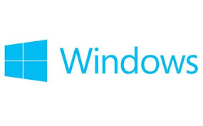
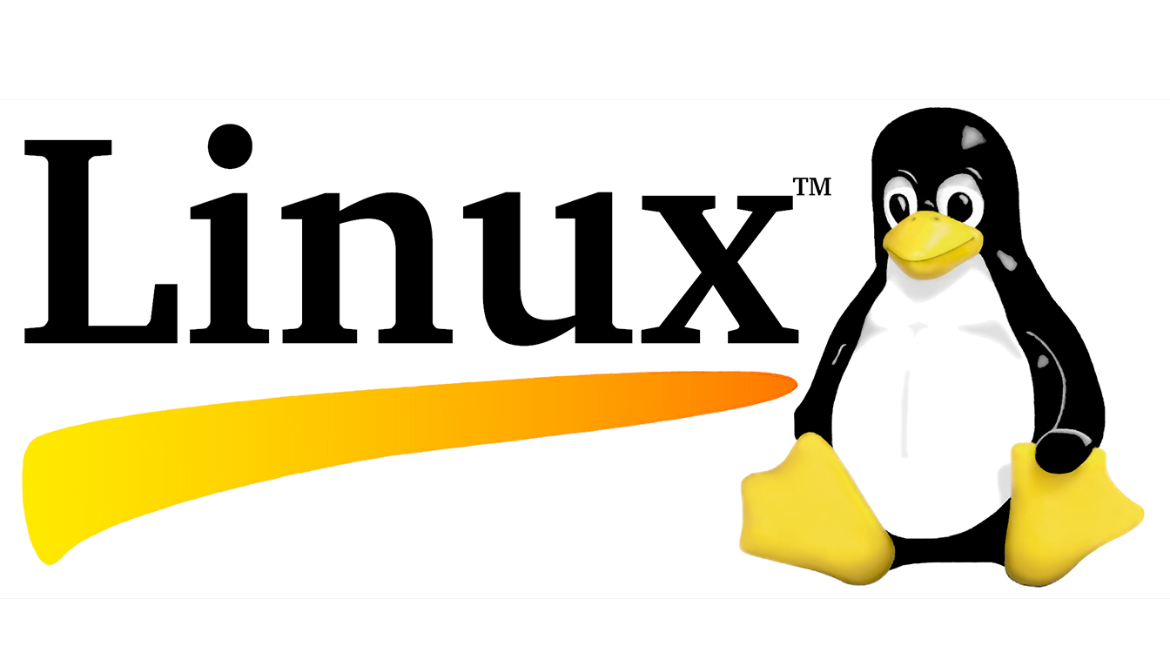
Working towards a release process
Looking to automate release process - regular builds
Seb James - many years experience producing high use software
Packaging Linux spineCreator for inclusion in Debian
Creating an installer for the Windows version of spineCreator
Constructed a Mac .app which is self contained

Slide 10
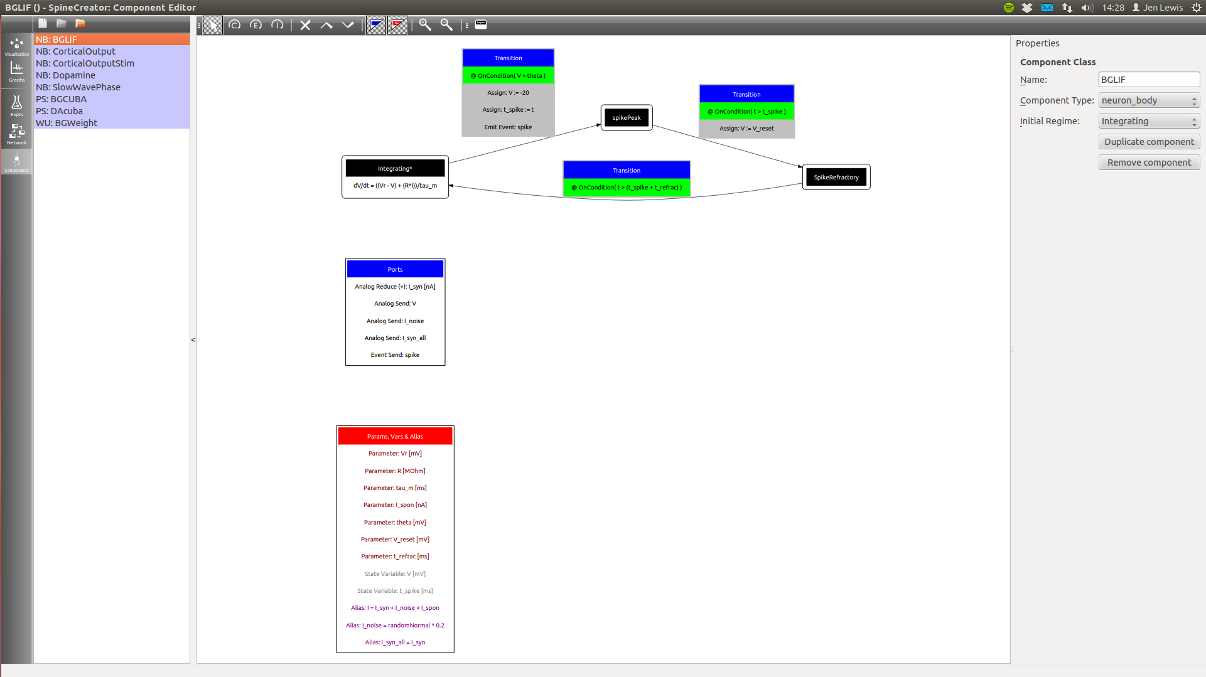
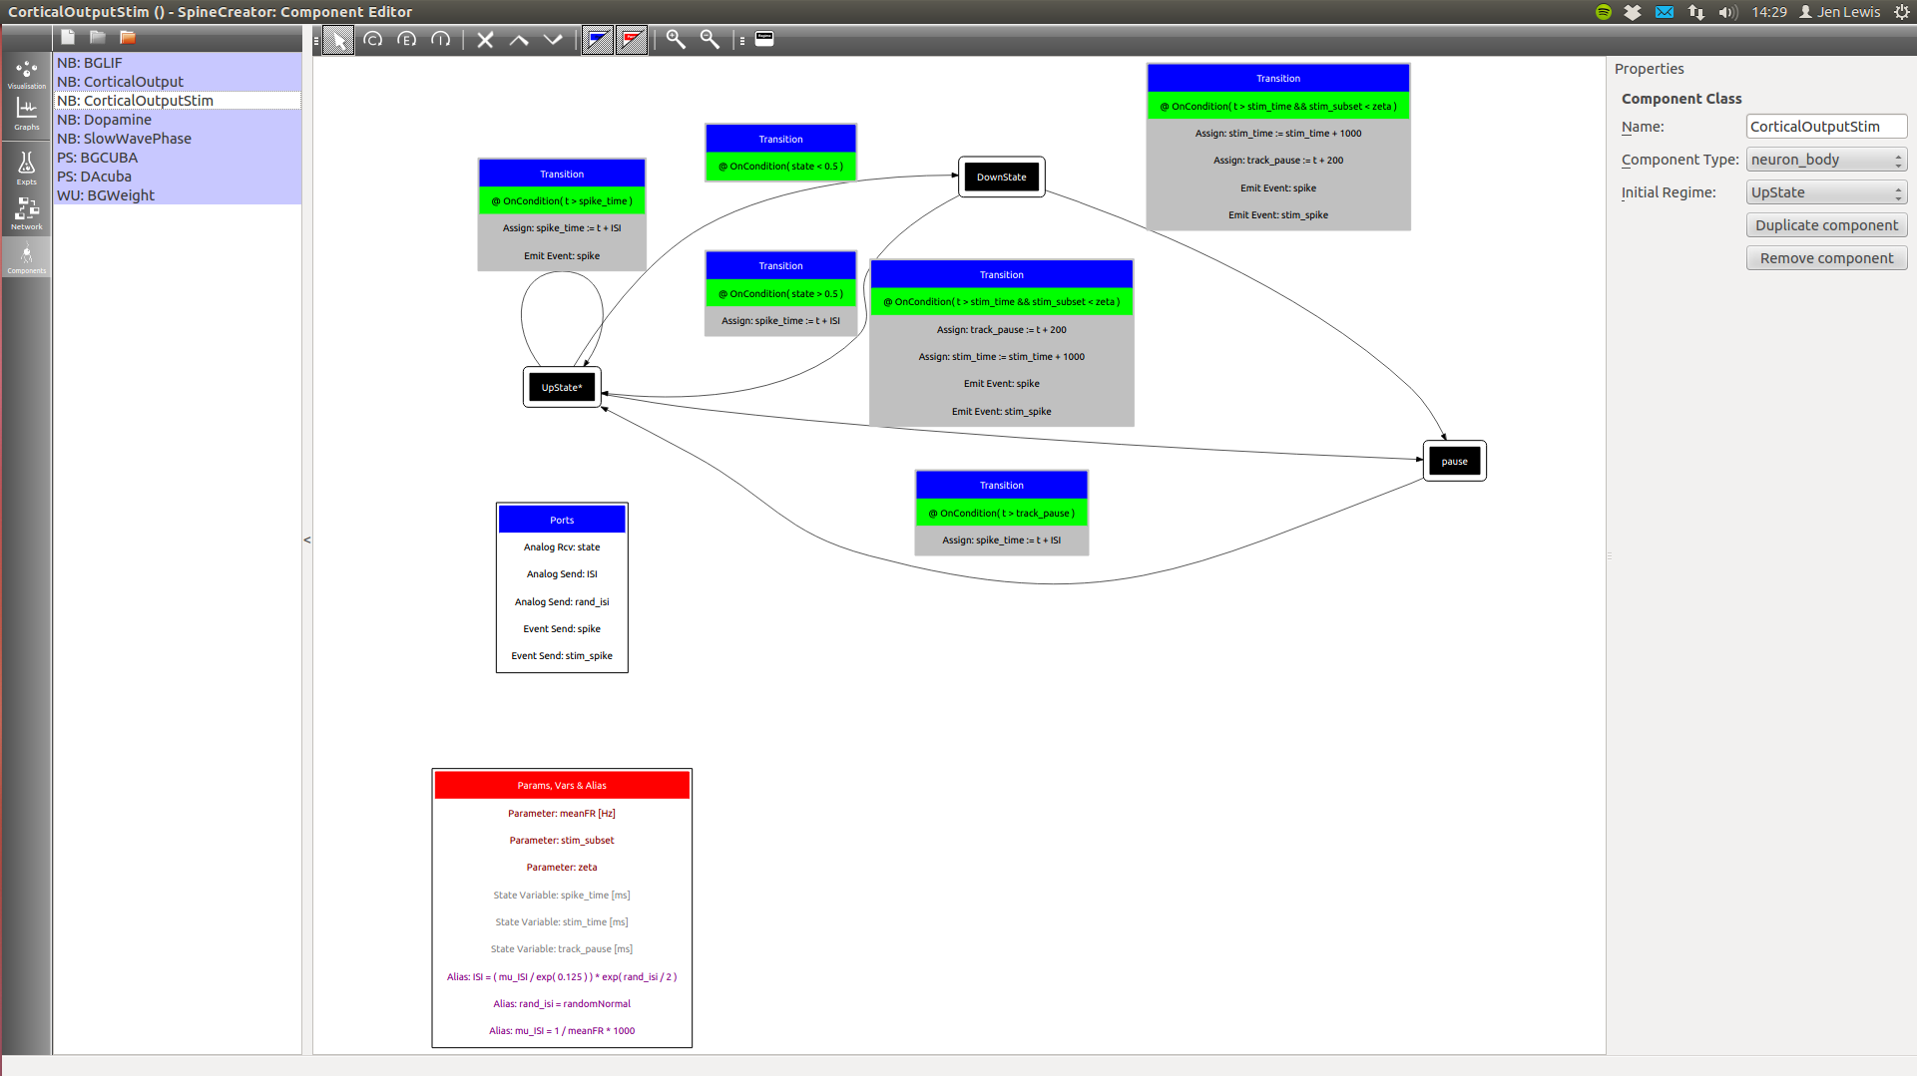
Basal ganglia model development using SpineCreator
Component layer:
Above: simple LIF neuron model
Right: more complex, abstract non-
neuron component – generates cortical input spikes

Slide 11
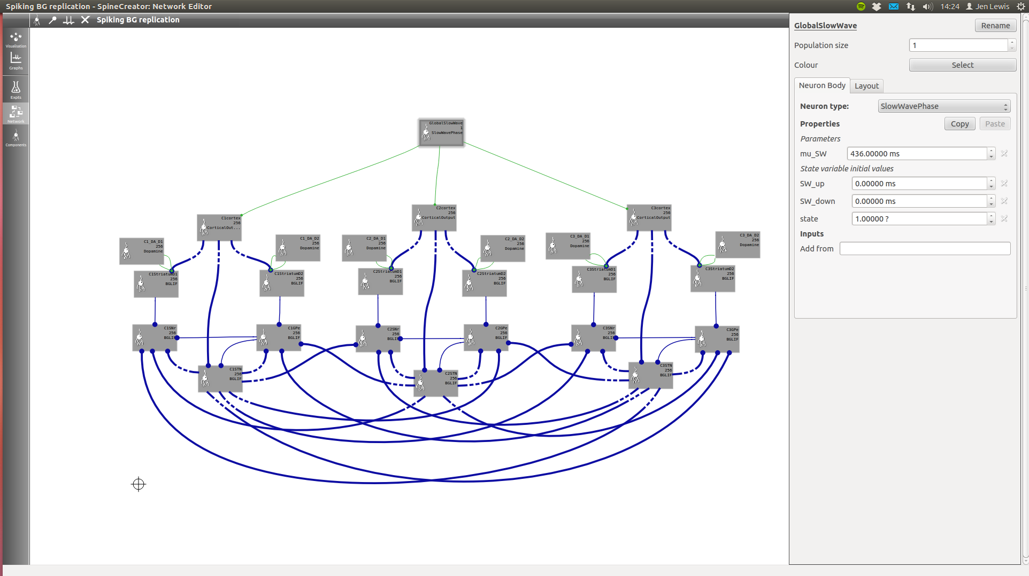
Basal ganglia model development using SpineCreator
Network layer:
Three basal ganglia ‘channels’ with segregated and convergent connectivity

Slide 12
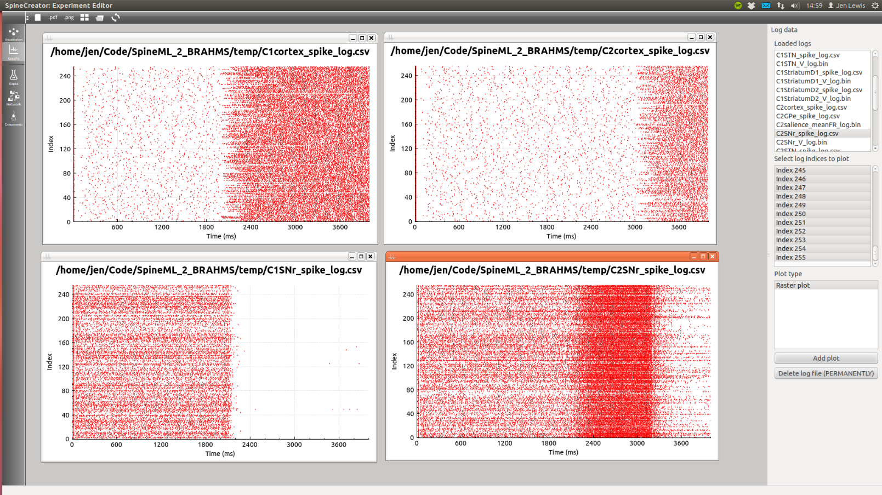
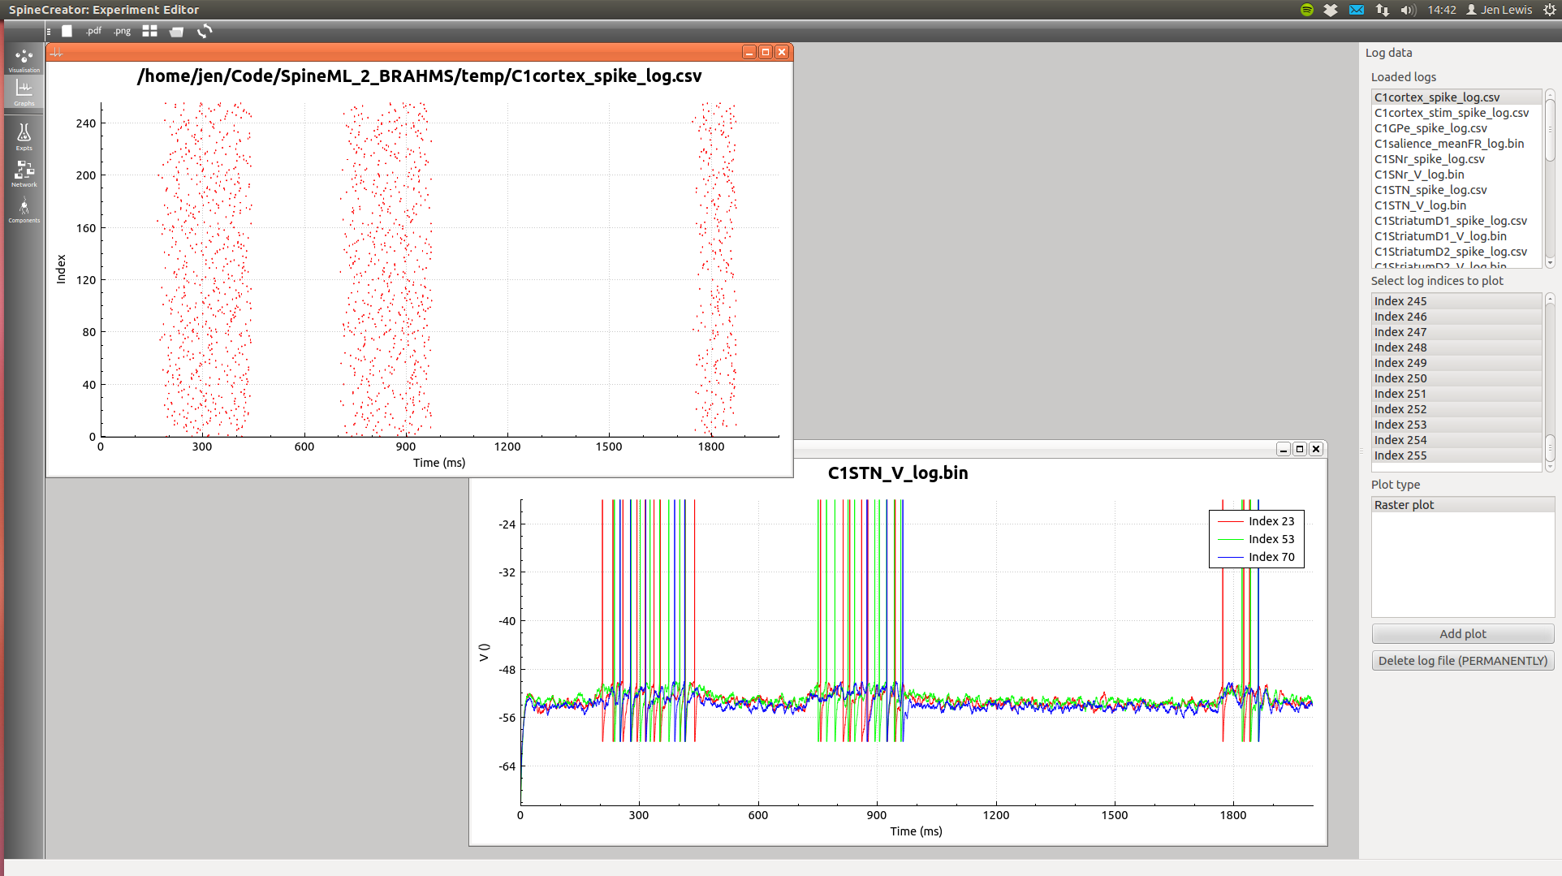
Basal ganglia model development using SpineCreator
Visualisation:
Graphing layer allows visualisation of spike times and voltage traces, illustrating single neuron responses to input (left) and complex firing rate relationships (above)

Slide 13
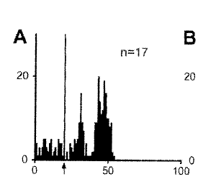
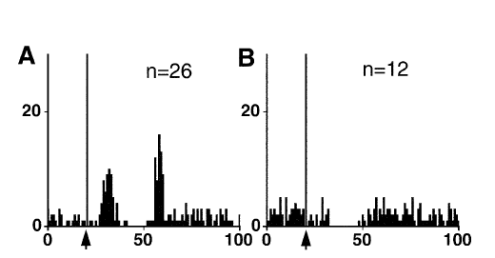
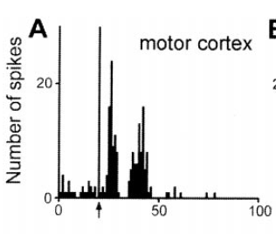
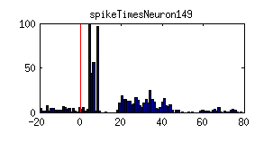
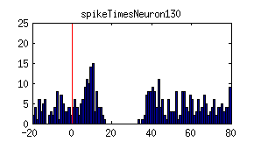
Preliminary results: cortical stimulation experiments
Subthalamic nucleus (STN) responses:
from Kolomiets et al., 2001
Substantia nigra (SNr) responses:
from Kolomiets et al., 2003
Model STN responses:
Small second peak? Under investigation!
Model SNr responses:
Good match to data!
Notes:
Cortex was stimulated at the time indicated by the arrows in the top histograms and by the red line in the model histograms.
Responses recorded in STN and SNr.
Model histograms show aggregate spike counts for ONE neuron over 100 stimulation experiments.
- Qualitatively a relatively good match for both, but second peak for STN is a bit small!

Slide 14
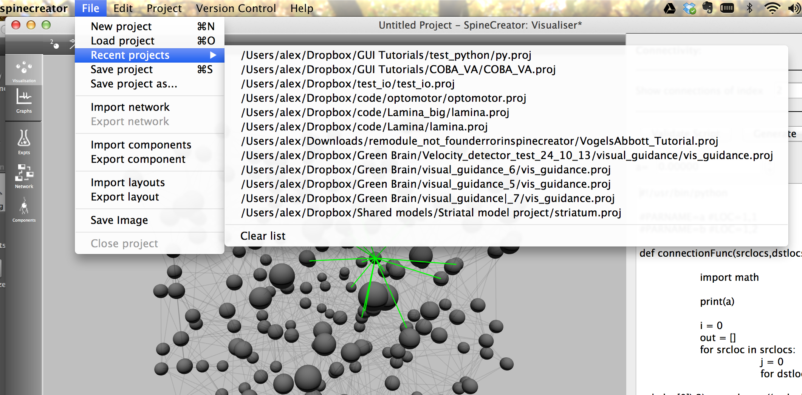
New features: projects
SpineCreator …

Slide 15
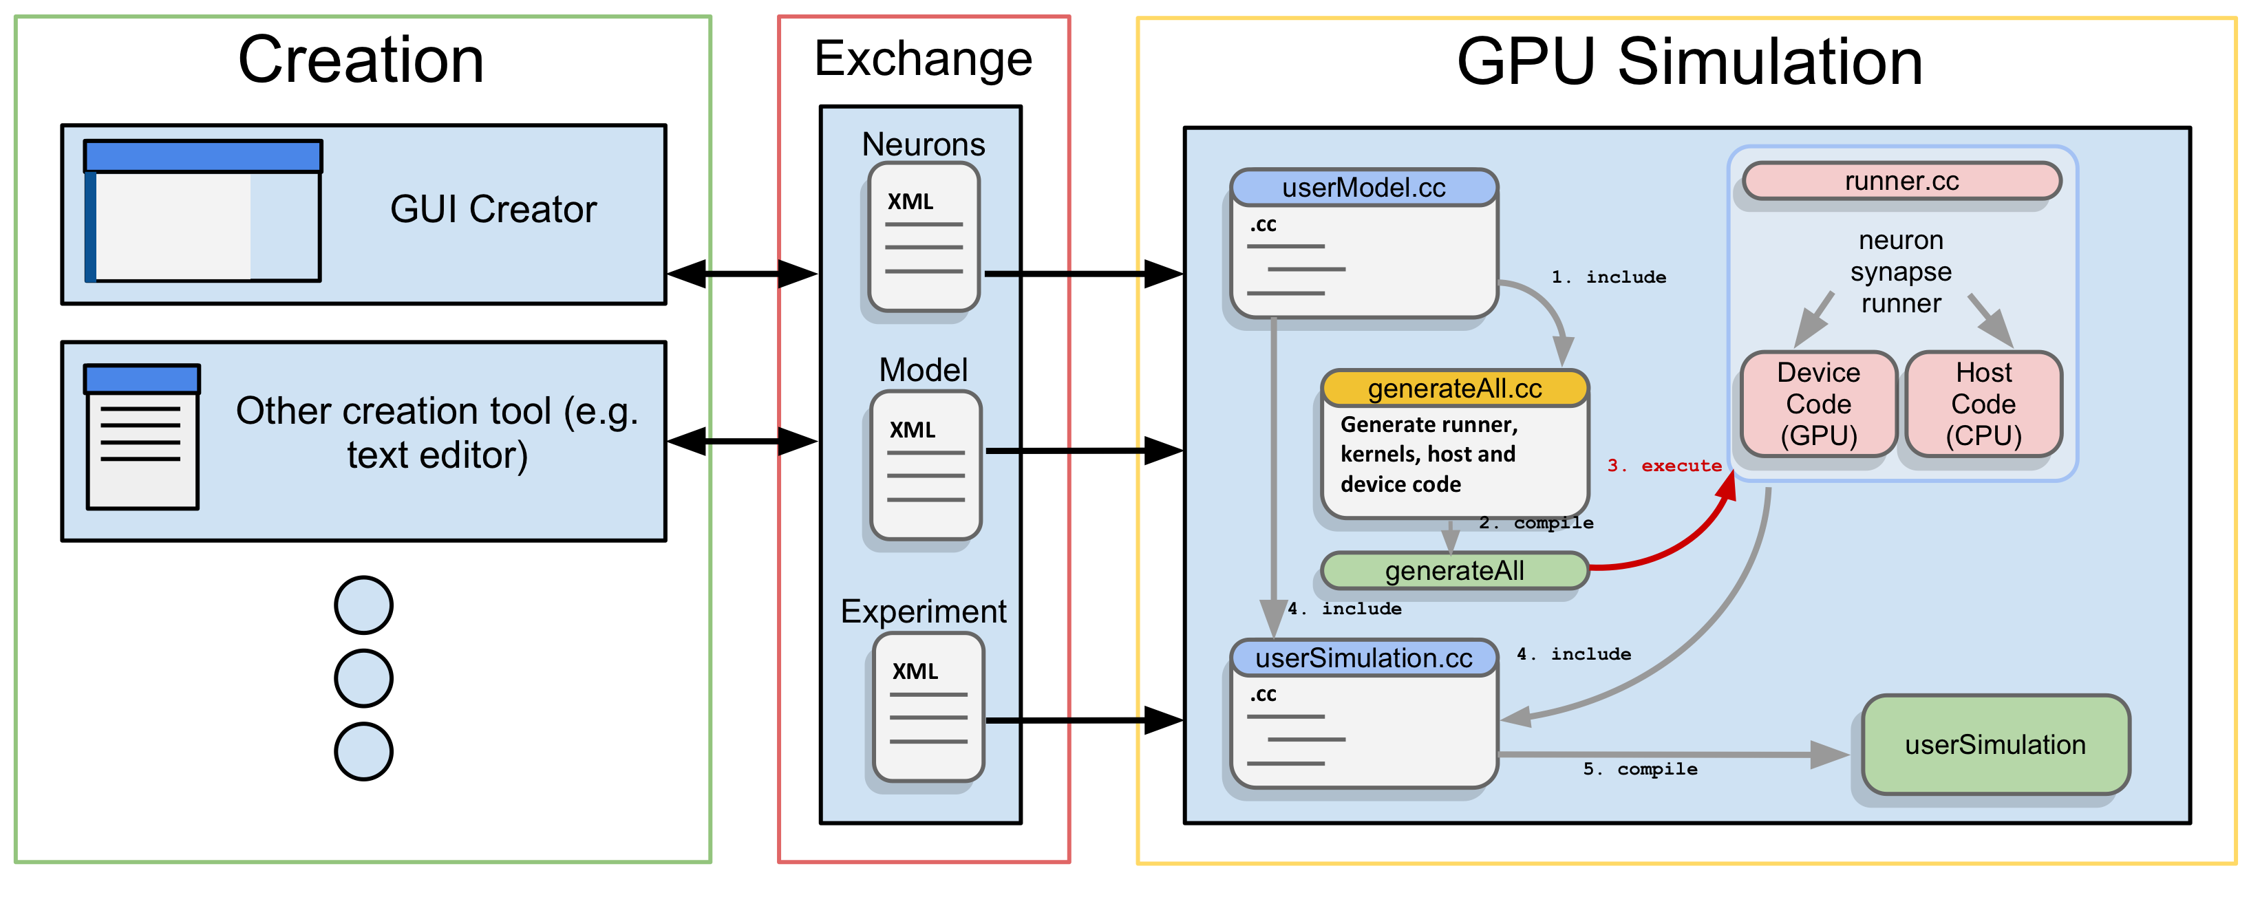
SpineML and GeNN
SpineML can use code generation for simulator support, so it is very easy to add support for GeNN
XSLT translation scripts transform the model into GeNN user files, and the GeNN standard toolchain compiles and runs the simulation
Support for new neuron types (and soon synapses and weight update rules) is supported through XSLT translation to GeNN system files

